Slide 1
WEB DEVELOPMENT
PHP & LARAVEL
LARAVEL
PROJECT

Slide 2
MD.FAWJUL AZIM
About Me
Department : CST
Semester : 8TH
Shift : 2ND
Roll : 586949
Registration : 1502155477
Session : 2020-21

Slide 3
Creative IT Institute
Internship
Creative IT Institute is a training institute that provides opportunities to acquire skills in various IT subjects including web development. Here I did internships in PHP and Laravel , which helped me to enhance my professional skills.

Slide 4
TABLE OF CONTENTS
01
04
About the Project
Project -01
02
05
Major Requirements
Project -02
03
06
Project Goals
Team
Web Development PHP & Laravel
PHP Project - Portfolio Overview
Technologies & Skills Learned
Raw PHP | Laravel | MySql | Laragoan
Laravel Project - Blog Site Overview
Objectives of the Internship Projects
Md.Fawjul Azim
Project Developer and Presenter

Slide 5
ABOUT THE PROJECT
This internship project involved creating two web applications
using PHP and Laravel. The first project was a
portfolio website developed with raw PHP to showcase my
skills and work experience. The second project was a blog
site built with Laravel, which included features such as
category-based posting, post management, commenting,
and reply functionalities.

Slide 6
MAJOR REQUIREMENTS
Programming Languages
Database
Frontend Skills
PHP for backend (portfolio project) and Laravel framework for blog project.
MySQL database to store and manage data efficiently for both projects.
HTML, CSS, and JavaScript to design and enhance user experience on both projects.

Slide 7
Project GOALS
Skill Development
Content Management
USABILITY
Improve PHP and Laravel skills by working on real-world projects, focusing on both frontend and backend functionalities.
Provide easy content management features for authors and admins, allowing them to organize and update content efficiently.
Develop user-friendly interfaces for both the blog and portfolio sites to enhance user experience.

Slide 8
Portfolio Project
Framework: Raw PHP
Database: MySQL
Features :
Admin login and logout page
Personal profile, expertise, services, portfolio showcase
Contact form
Extra:
Admin panel for managing content and feedback

Slide 9
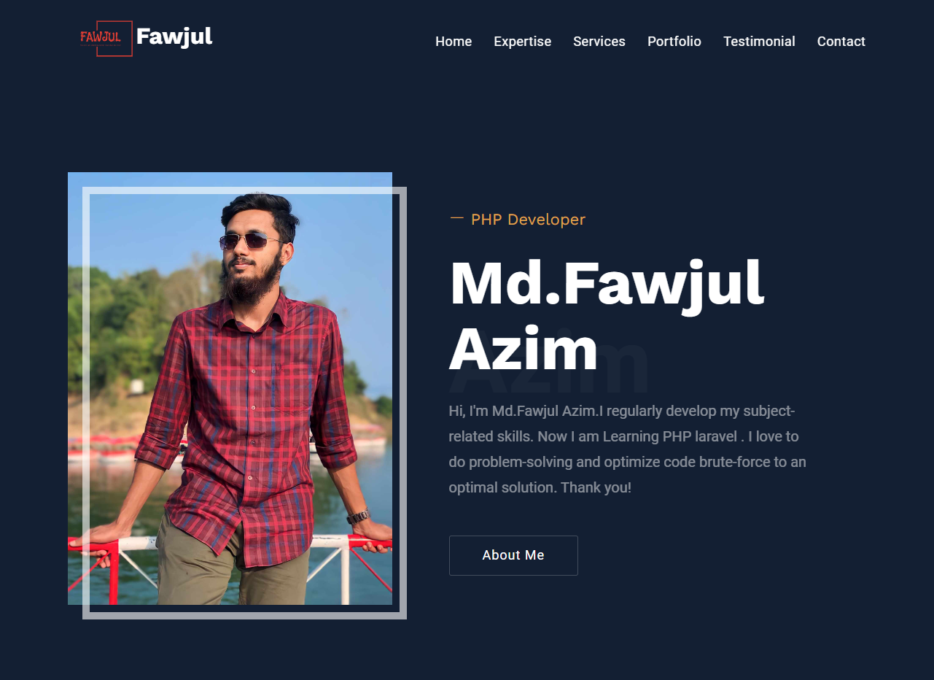
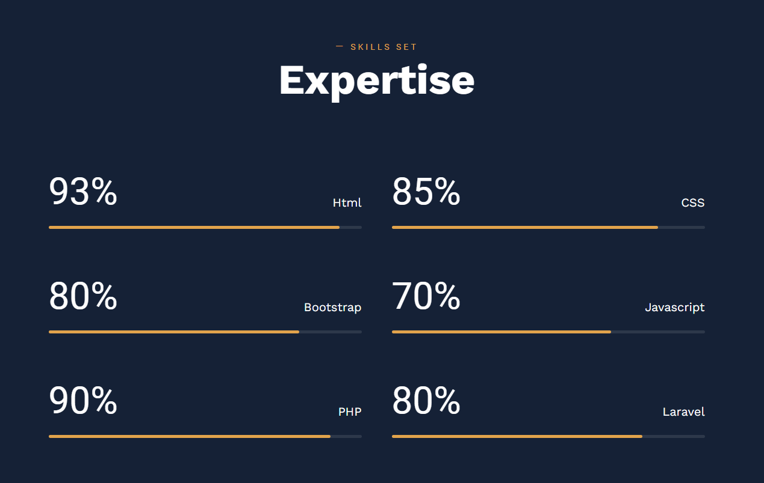
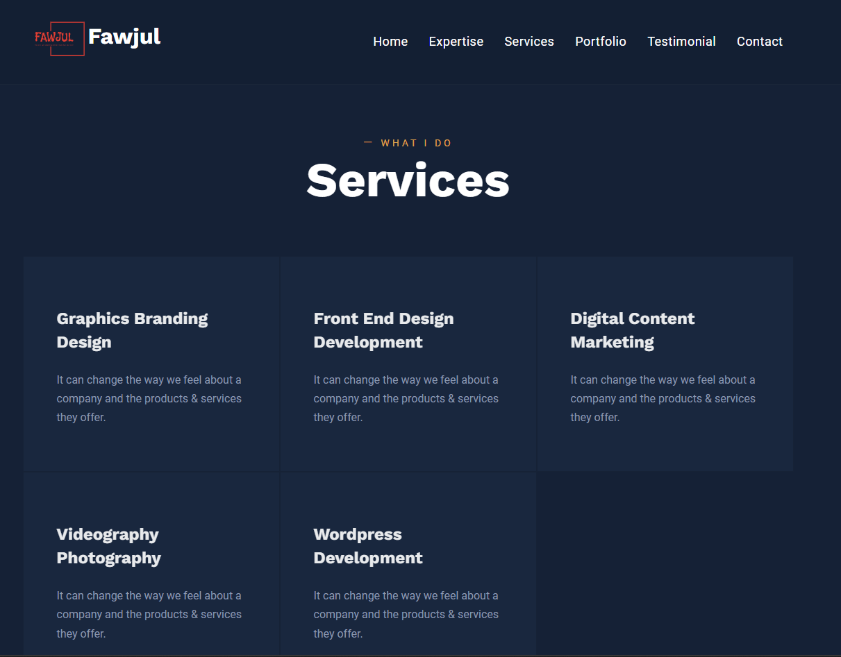
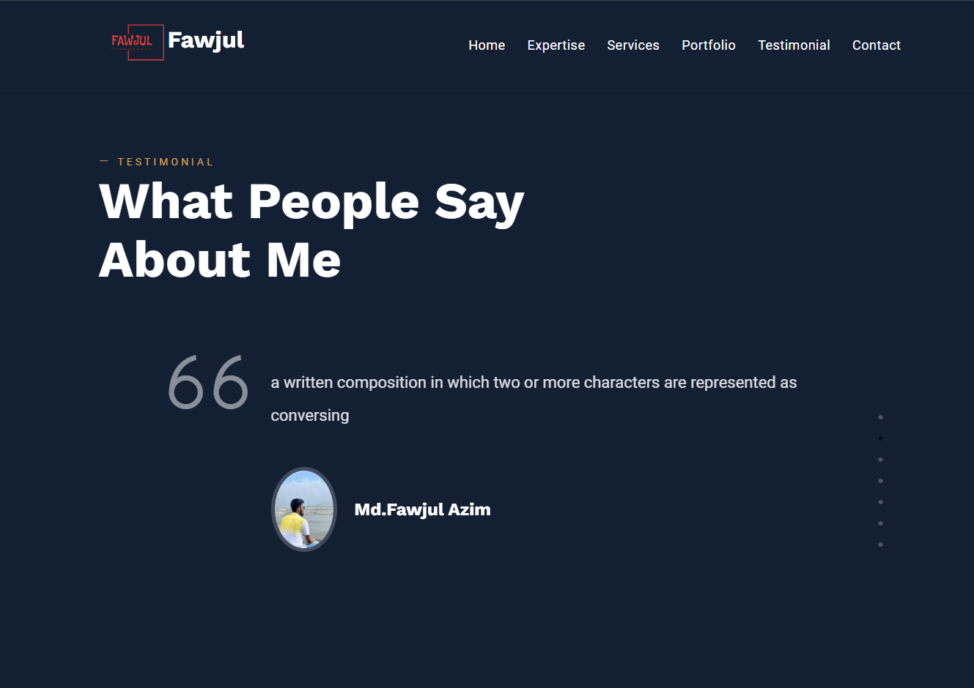
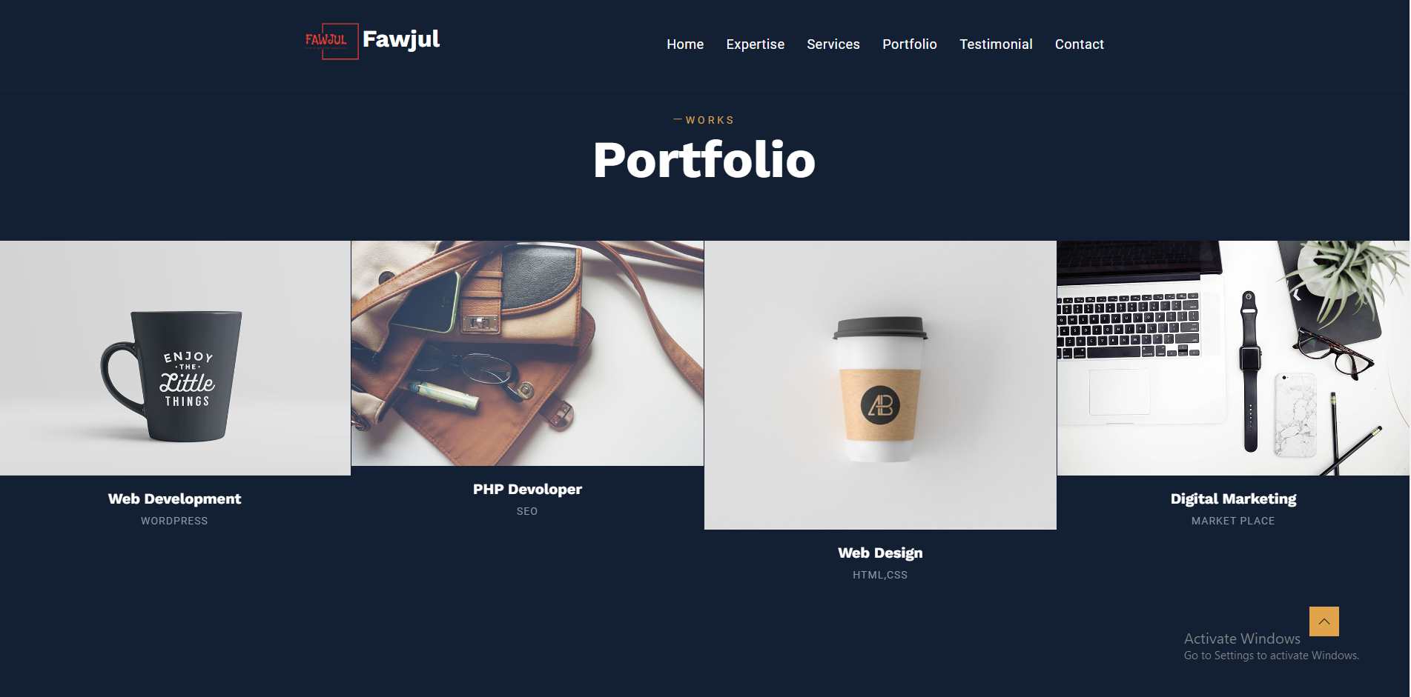
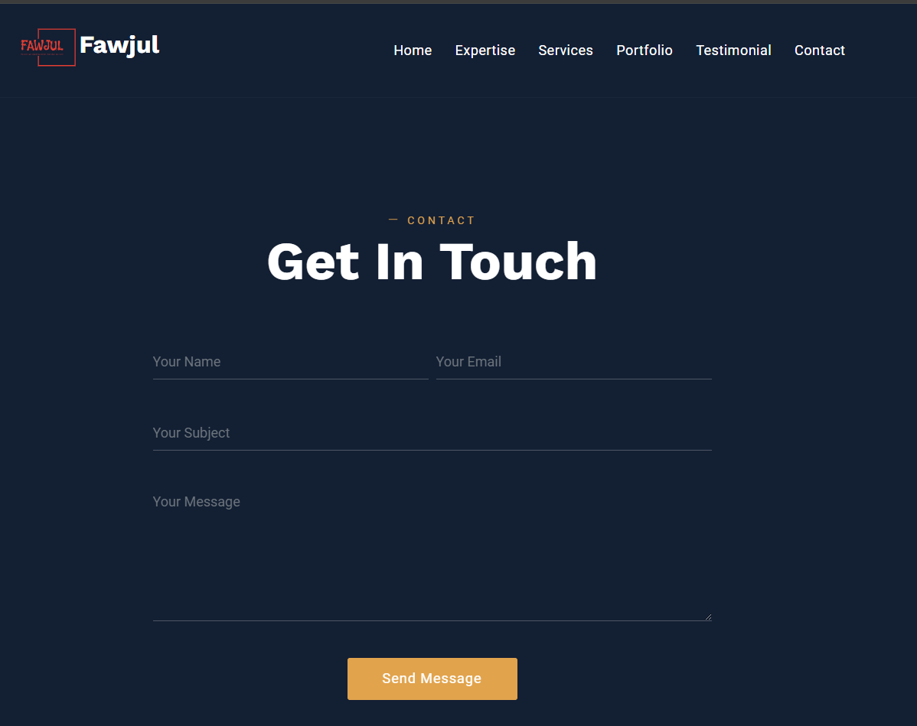
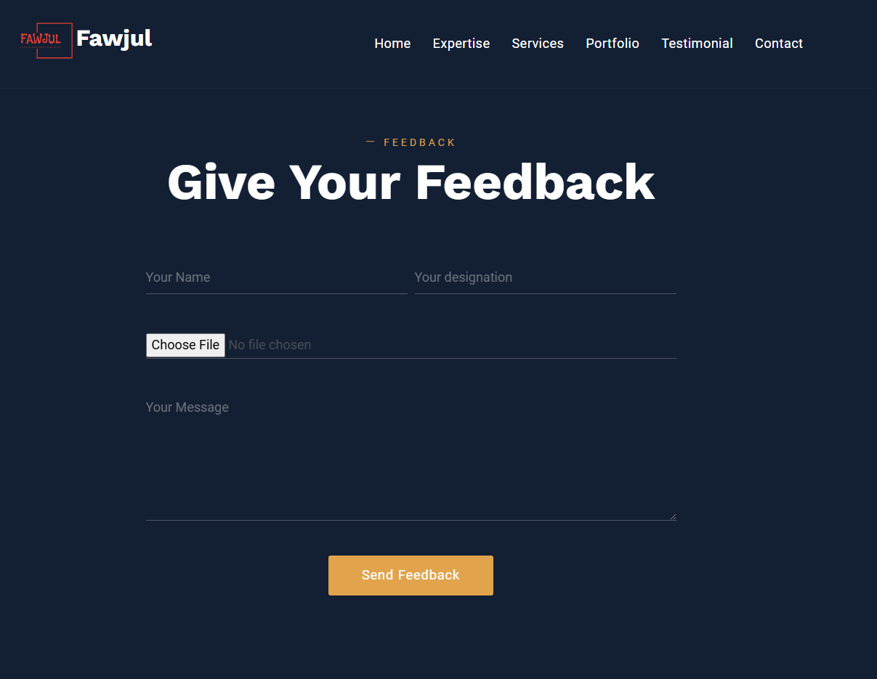
PHP Project – Portfolio Fronted Overview
This portfolio website was created using PHP, with a focus on both frontend and backend development. The frontend design includes sections like Expertise, Services, Portfolio, and Contact, making it user-friendly and visually appealing. Currently, the frontend is complete. In the next phase, I will add backend features, such as contact form submission, collecting client feedback, and updating content through a database.

Slide 10
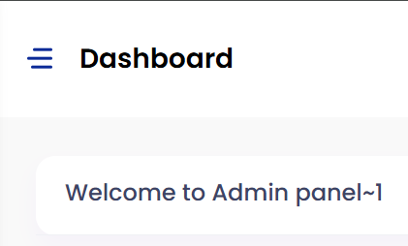
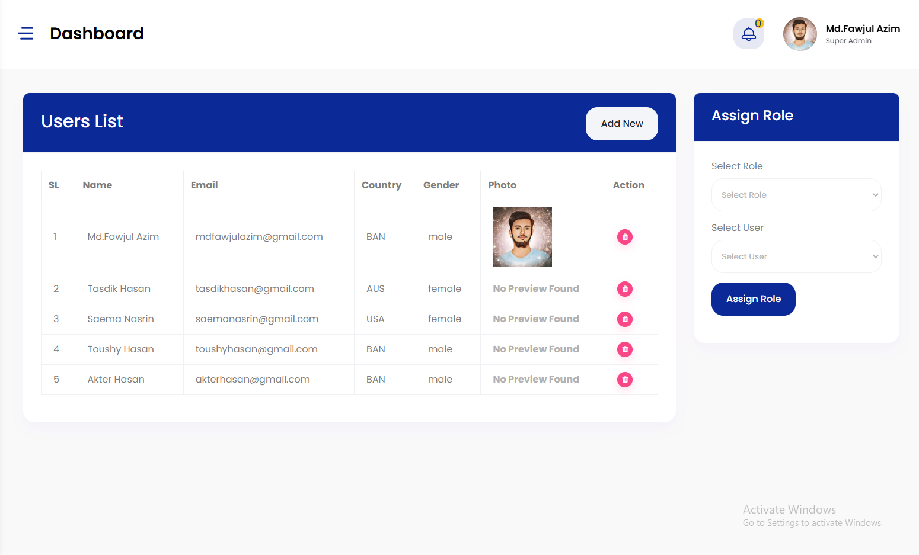
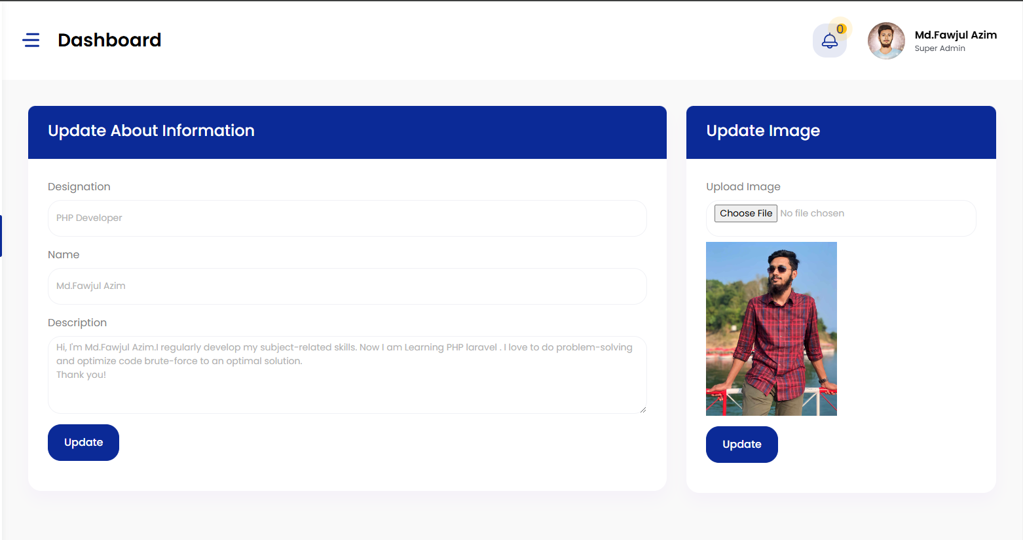
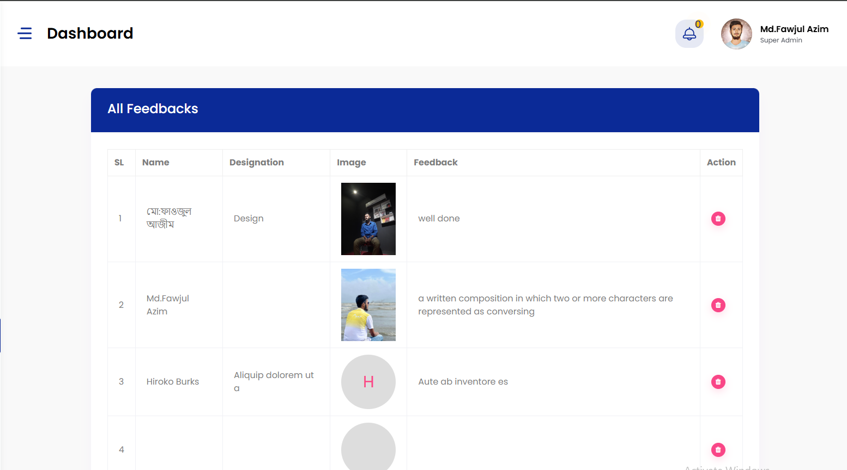
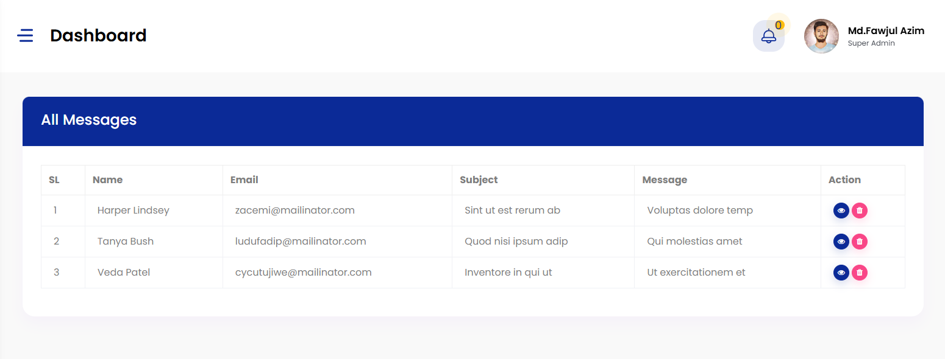
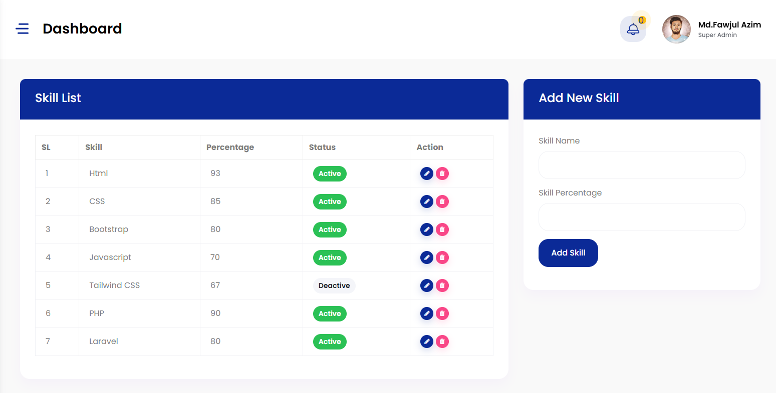
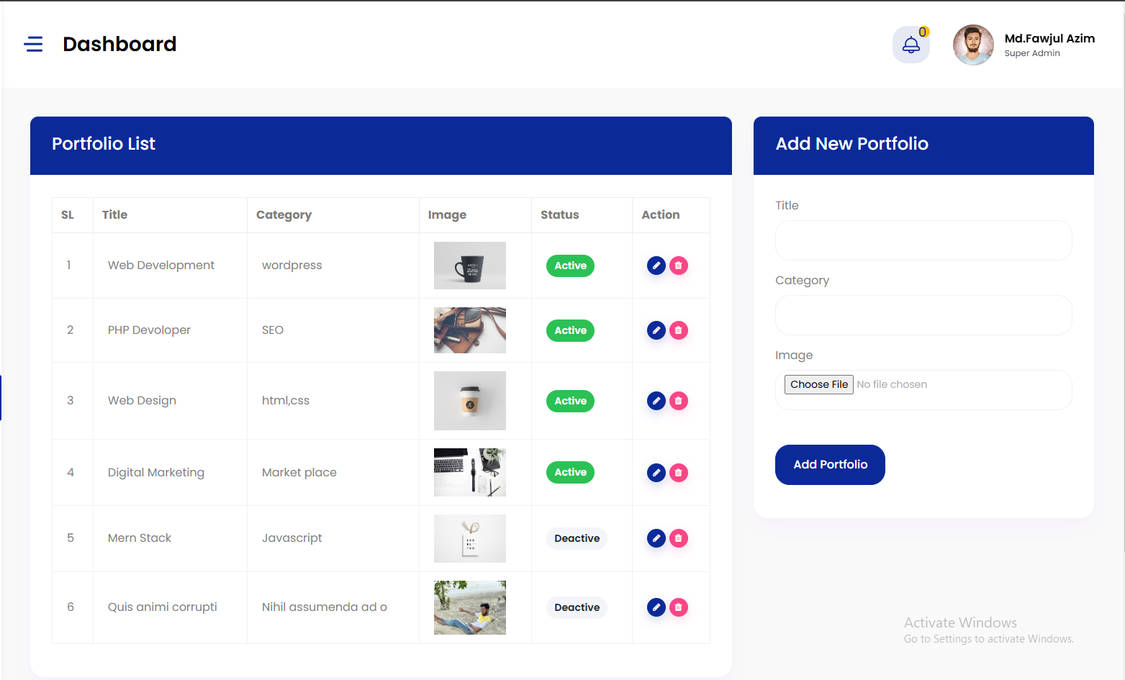
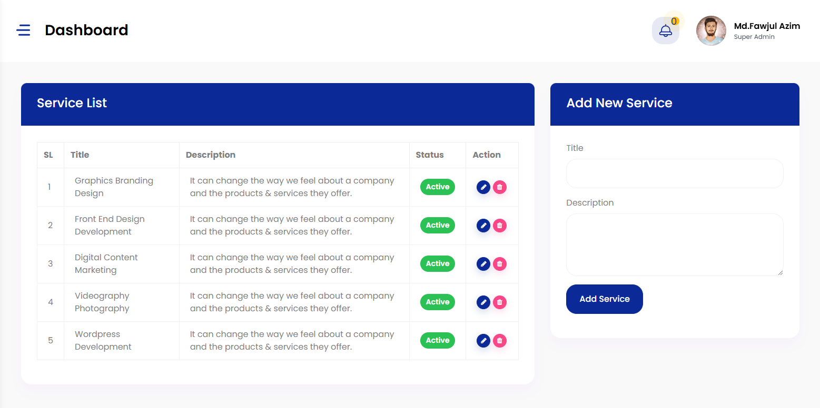
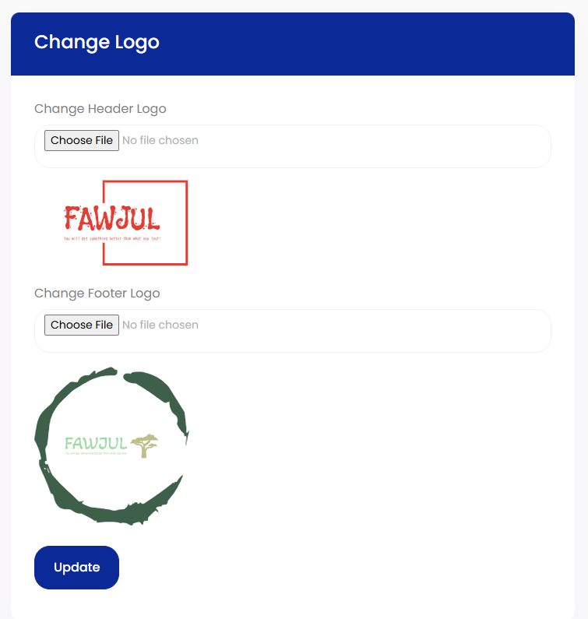
PHP Project – Portfolio Backend Overview
This is the Admin Panel developed for managing the portfolio website. The backend allows for easy control over different aspects of the site, including:
User Management : Adding and managing user roles.
Portfolio Management : Adding and editing portfolio items.
Profile Updates : Updating profile information and profile picture.
Skill Management : Adding new skills and managing existing skills.
Service Management : Managing offered services, including adding new services.
Feedback Management : Viewing and responding to client feedback.
Logo and Branding : Updating logos and other branding elements.
This backend system provides a structured and efficient way to control website content, ensuring smooth and professional management of all sections.

Slide 11
Blog Project
Framework: Laravel
LARAVEL
Database: MySQL
Features:
Separate login and logout for admin and authors
Email verification with message send and verification process
Post management, categories, tags, comments
Admin panel for user roles and content control
Extra: Subscriptions, FAQs, and contact management

Slide 12
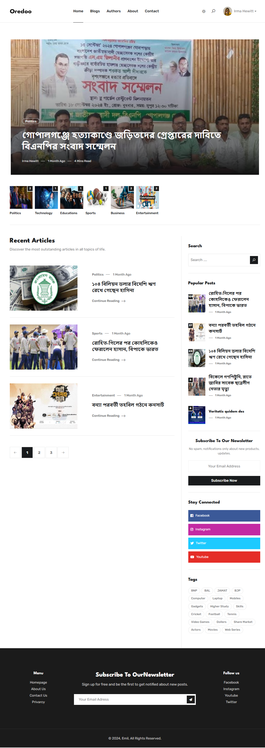
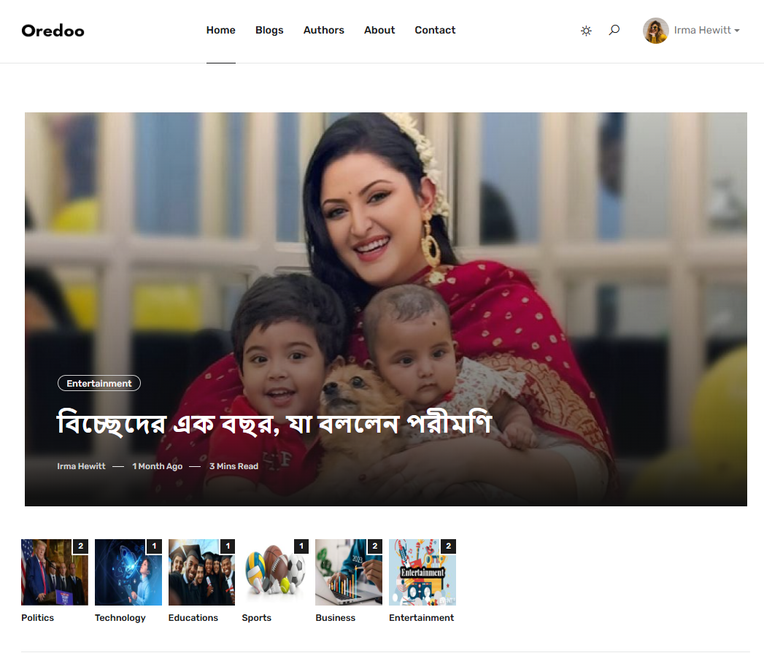
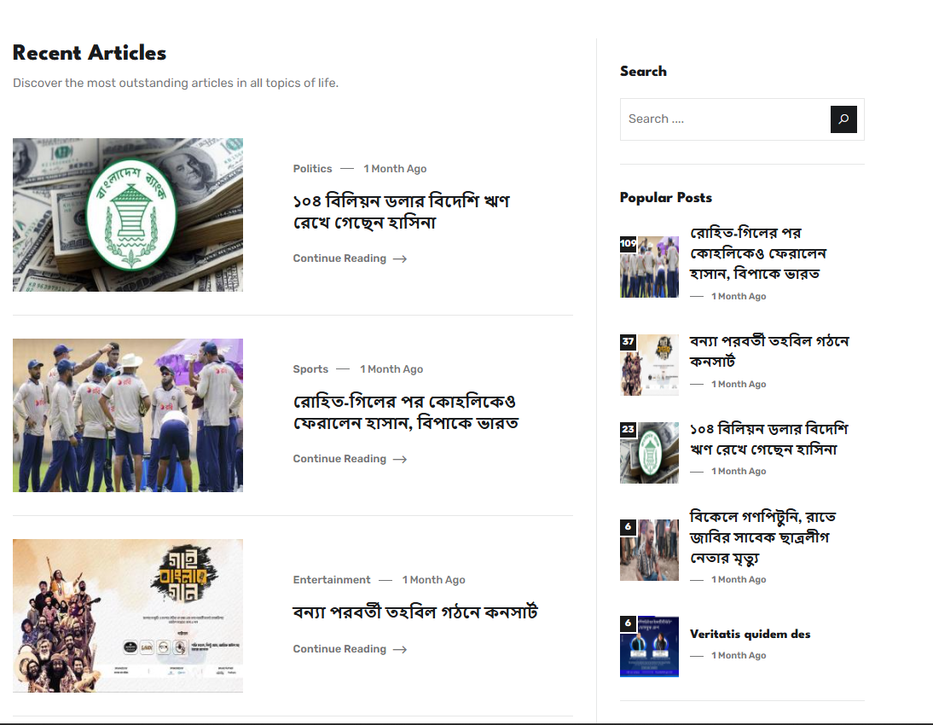
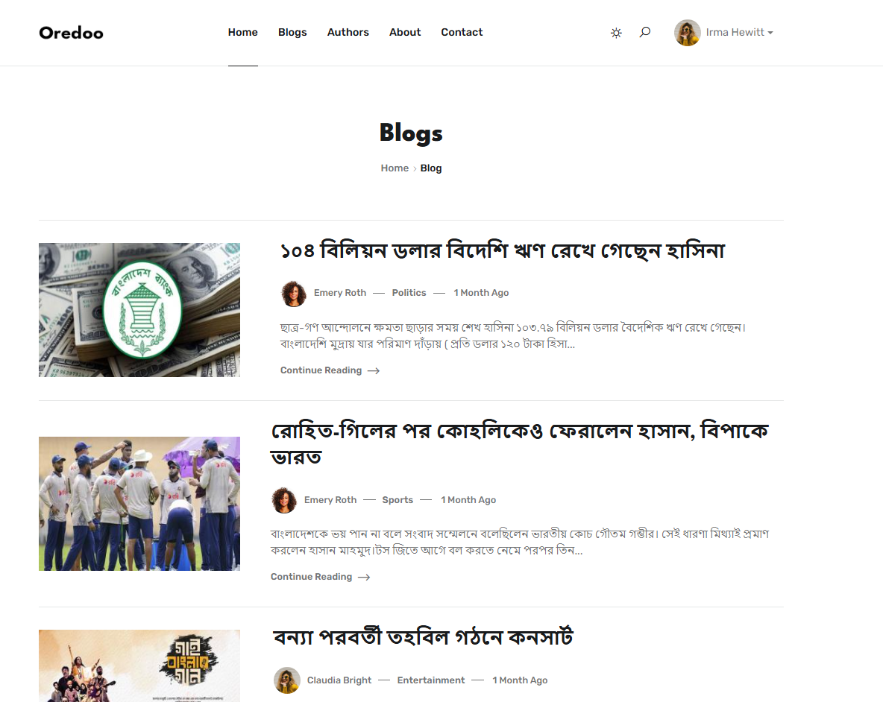
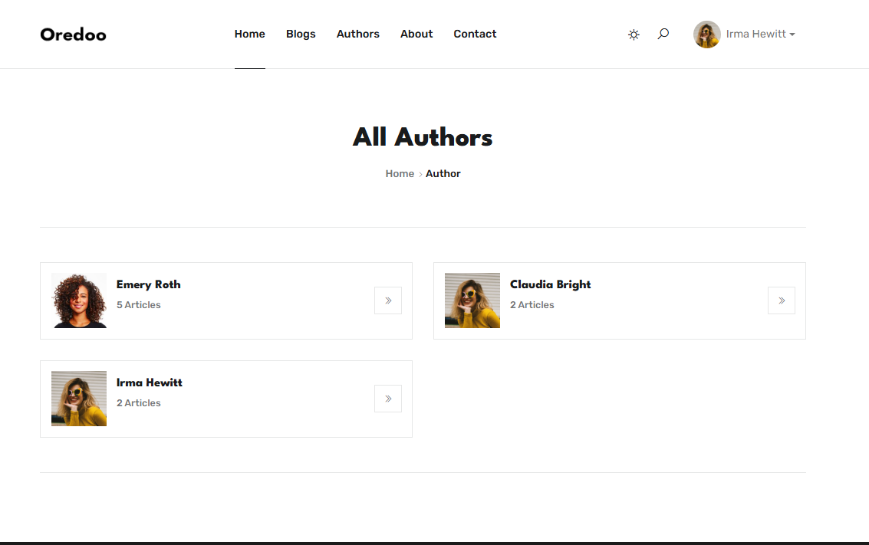
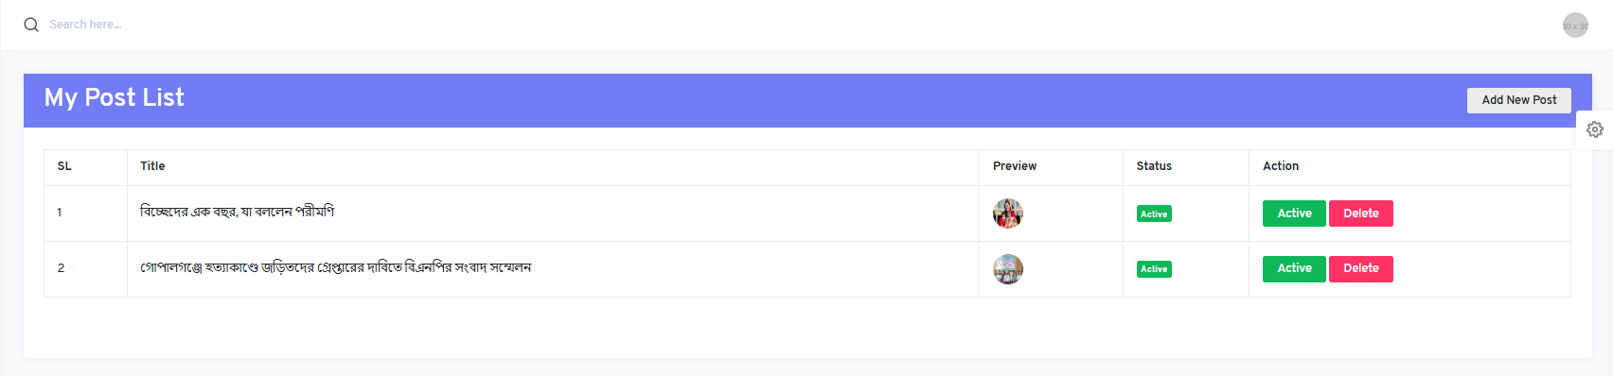
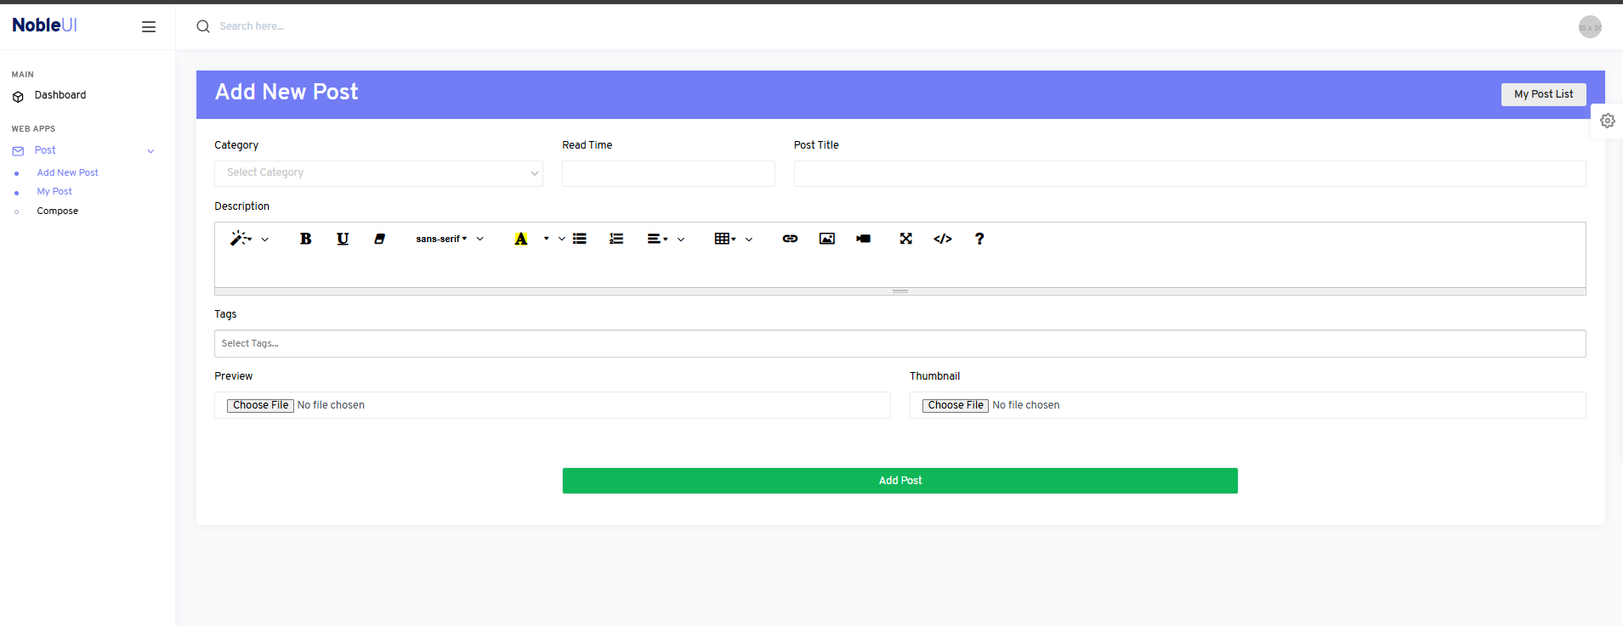
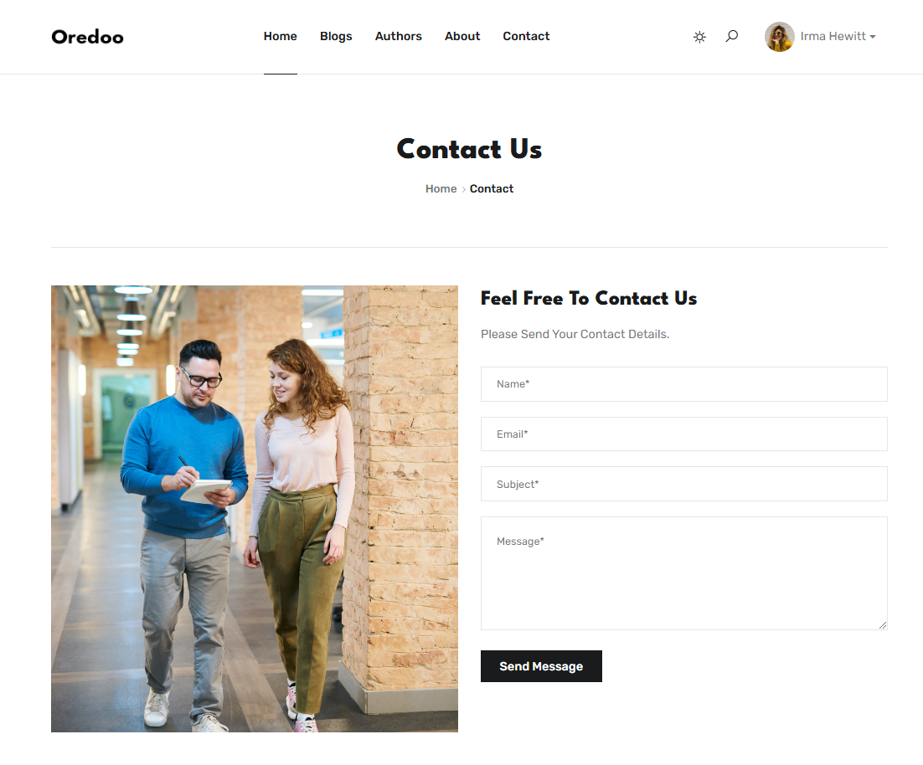
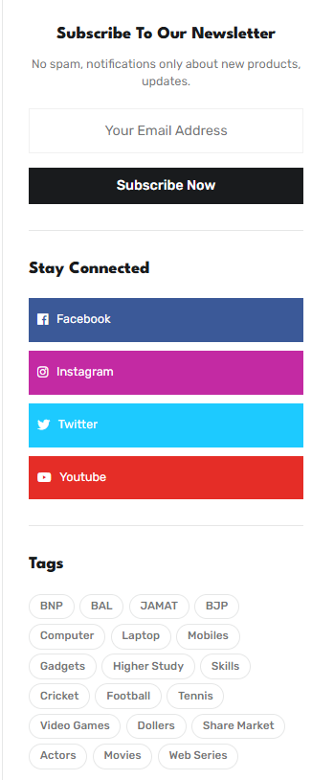
Laravel Project – Blog Site Authors Overview
This section is for Authors on the blog site. Authors can easily manage their posts and organize content.
View Posts : Authors can see all their posts in one place.
Manage Posts : Authors can edit, update, or delete their posts anytime.
Organize by Category and Tag: Authors can add categories and tags to posts, making it easy for readers to find similar content.
Filter Content : Authors can filter posts by category or tag to quickly find specific posts.
These features make it simple for authors to keep their content organized and easy to manage.

Slide 13
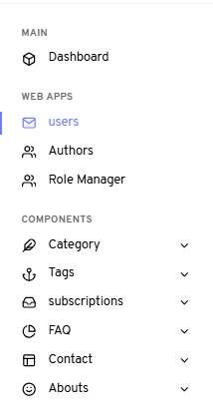
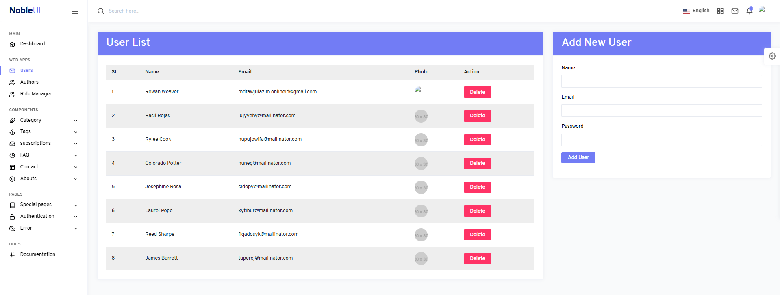
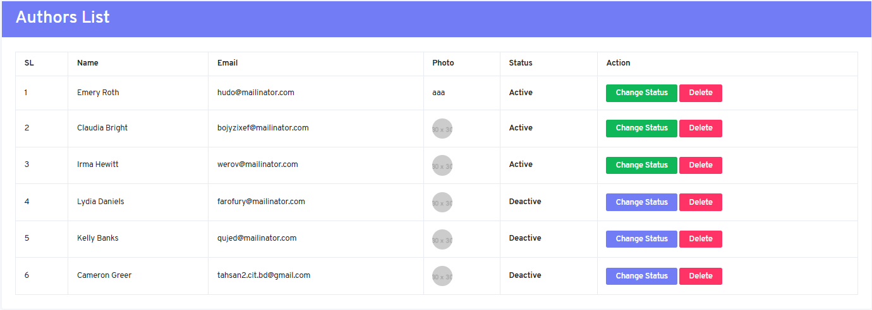
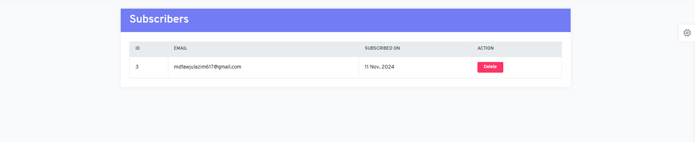
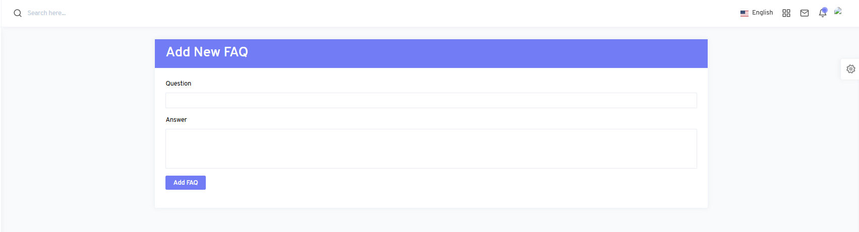
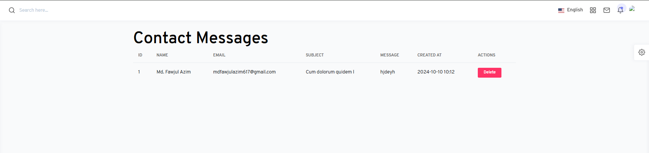
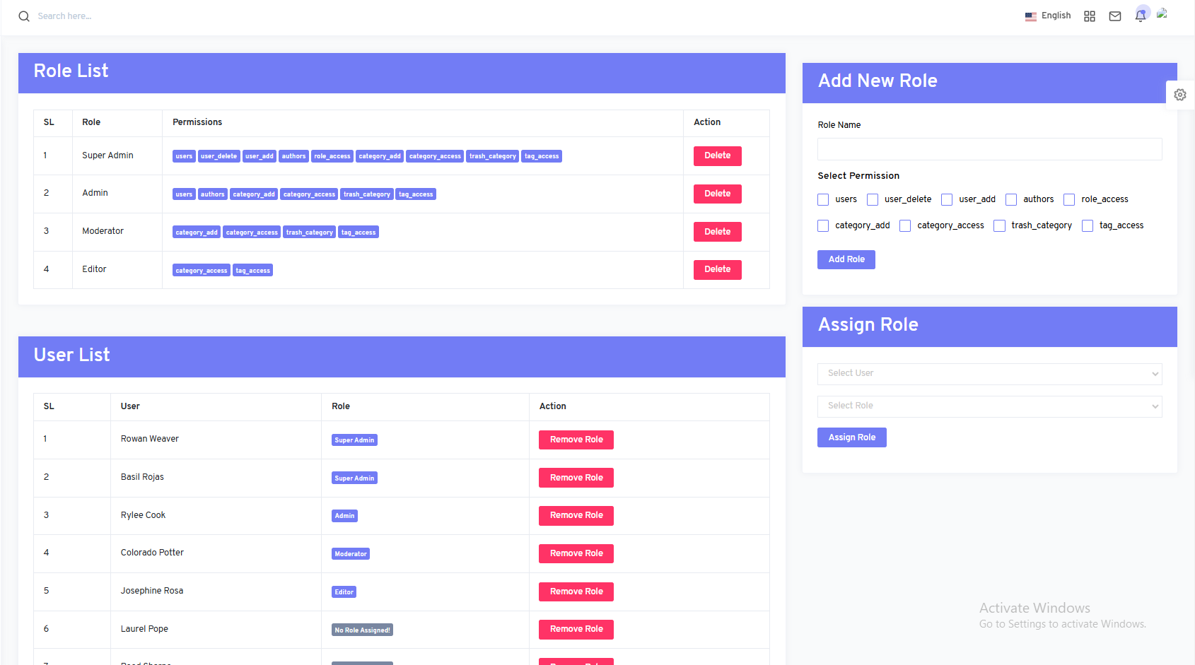
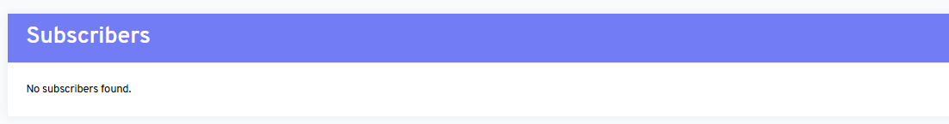
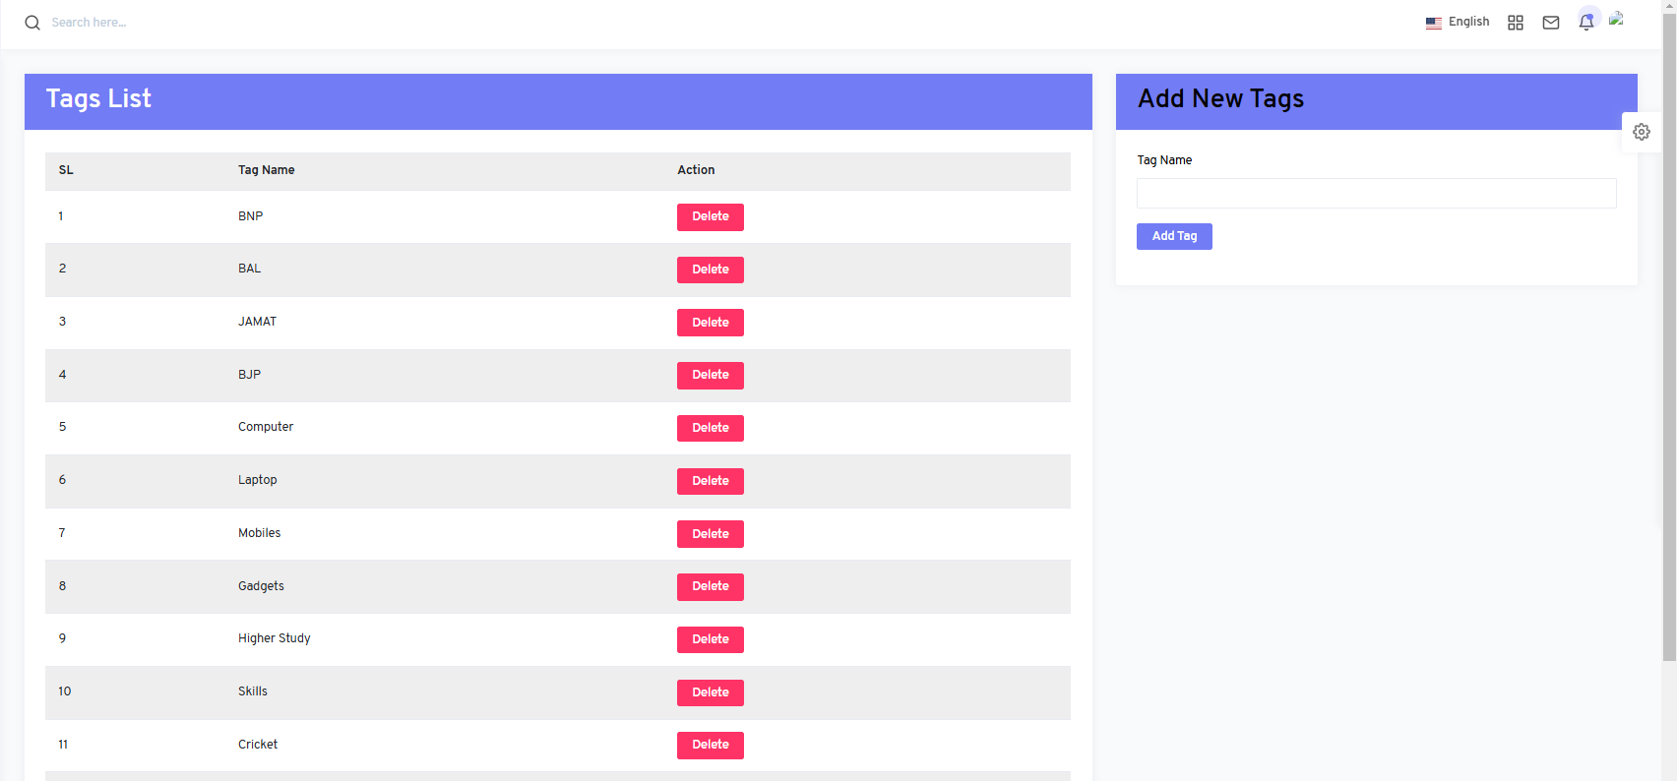
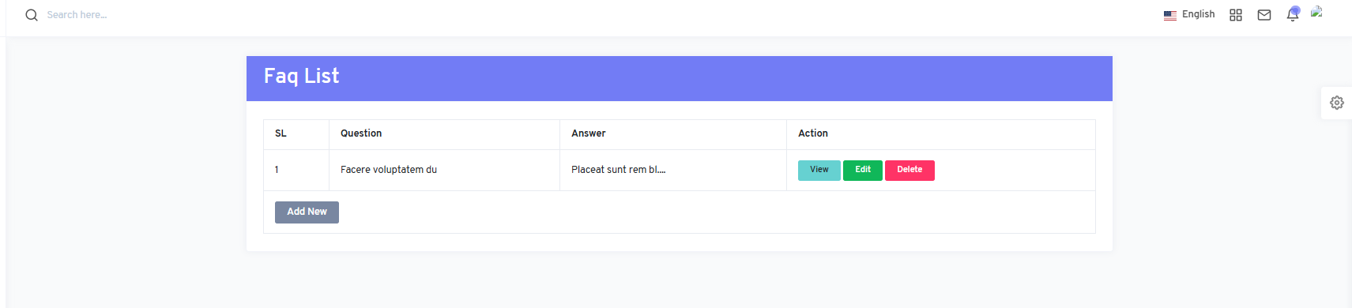
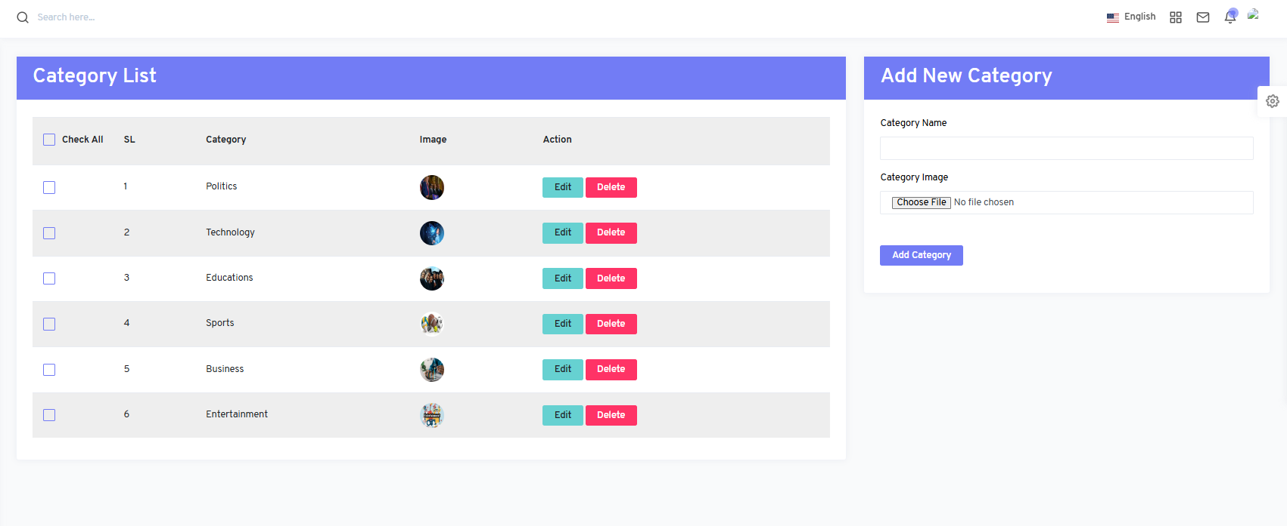
Laravel Project – Blog Site Admin Panel Overview
This is the Admin Panel for managing the blog site. Admins can easily control and organize the site content and user roles.
User Management : View and manage authors’ list and roles.
Role Management : Assign specific roles to users.
Category & Tags : Create and manage categories and tags for authors to use.
Subscriptions : Manage subscriber list.
FAQ & Contact : Update FAQs and handle contact messages.
About Page : Edit and update information on the about page.
These features make it easy for admins to keep the site organized and up-to-date.

Slide 14
OUR TIMELINE
MONTH 1
MONTH 2
PHP Basic
Project Complete
MONTH 1.5
MONTH 3
PHP PROJECT
Laravel Project
OOP Basic
Laravel Project

Slide 15
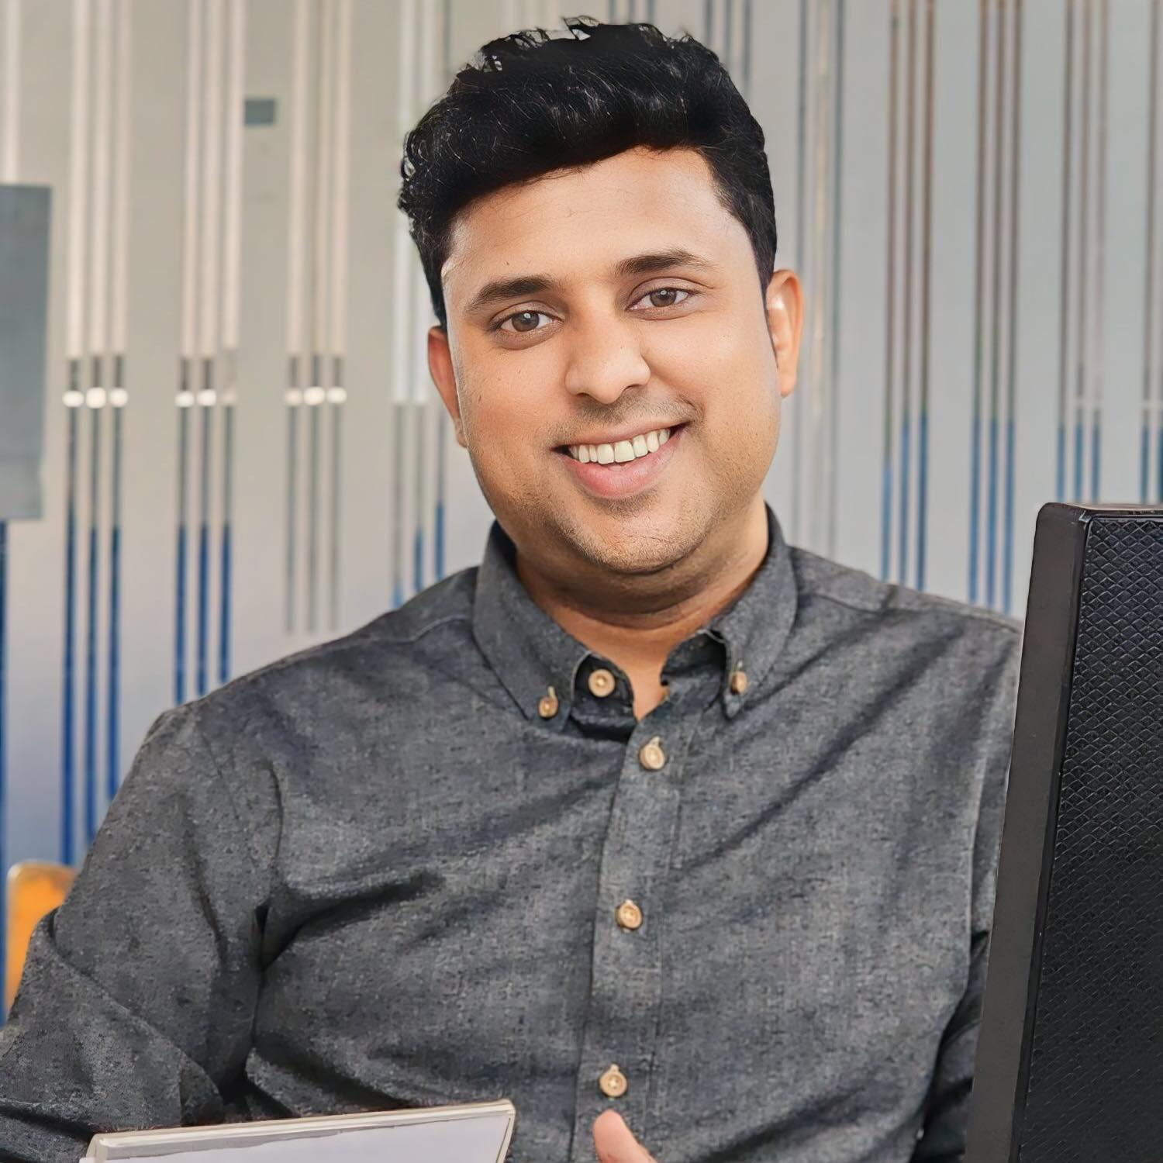
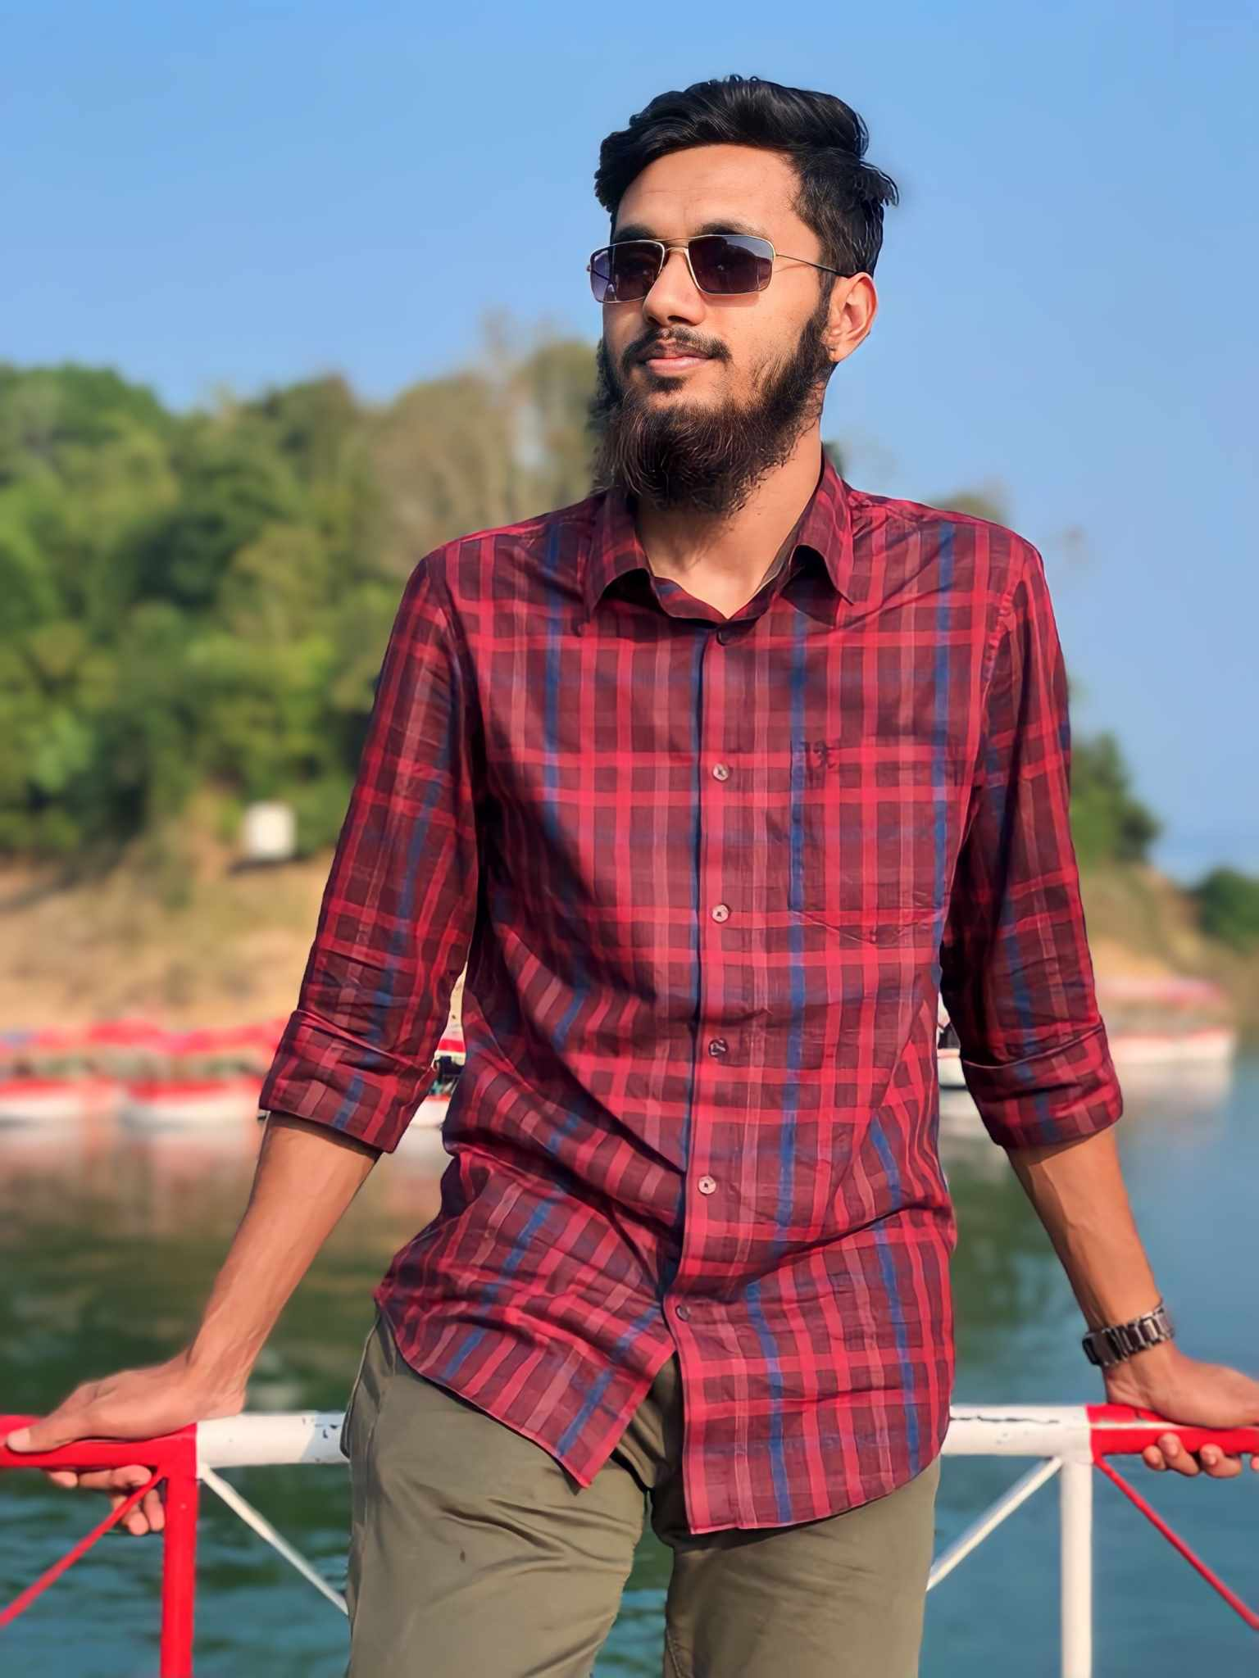
THE TEAM
Md.Fawjul Azim
Project Developer and Presenter
Mahadi Tahsan
Mentors
Faculty & Full-Stack Developer
Creative IT Institute

Slide 16
—Surah Al-Anfal: 70
"Surely you will receive something better than what you have lost."

Slide 17
THANKS!
LARAVEL
Does anyone have any question?
addyouremail@freepik.com
+8801644-213617
mdfawjulazim617@gmail.com

